Slide 1
Comp Photography (Fall 2015)
HW 3
Hieu Nguyen
CS 6475

Slide 2
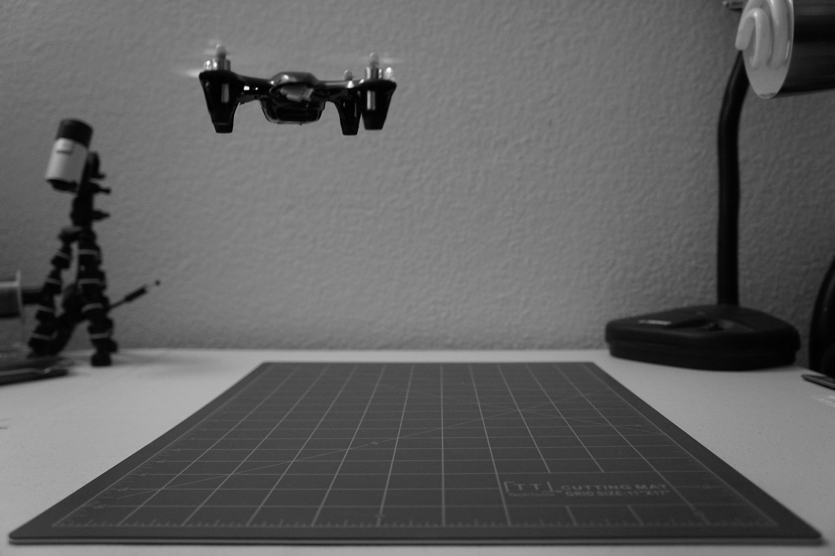
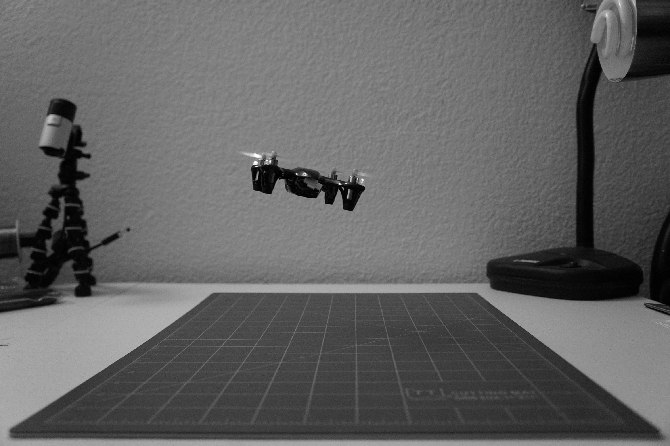
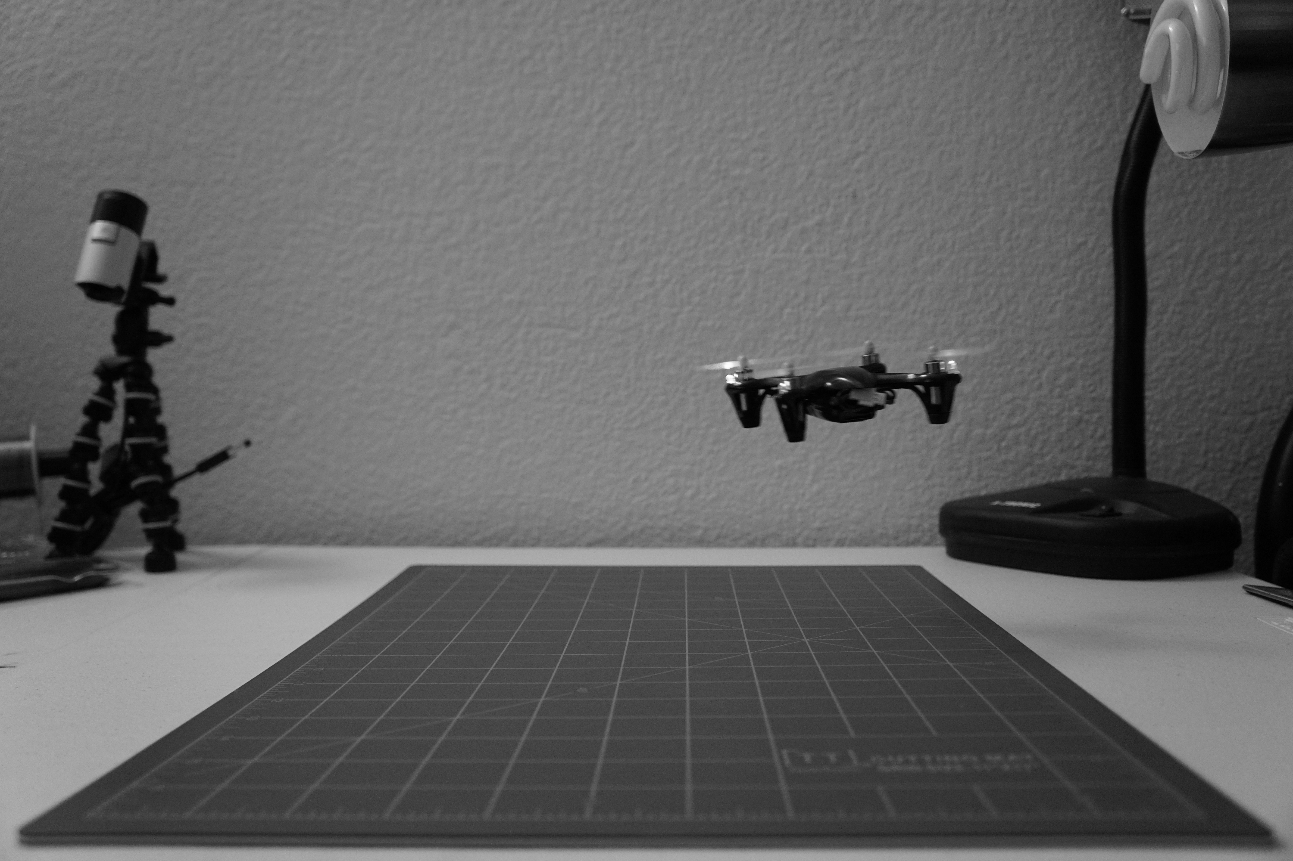
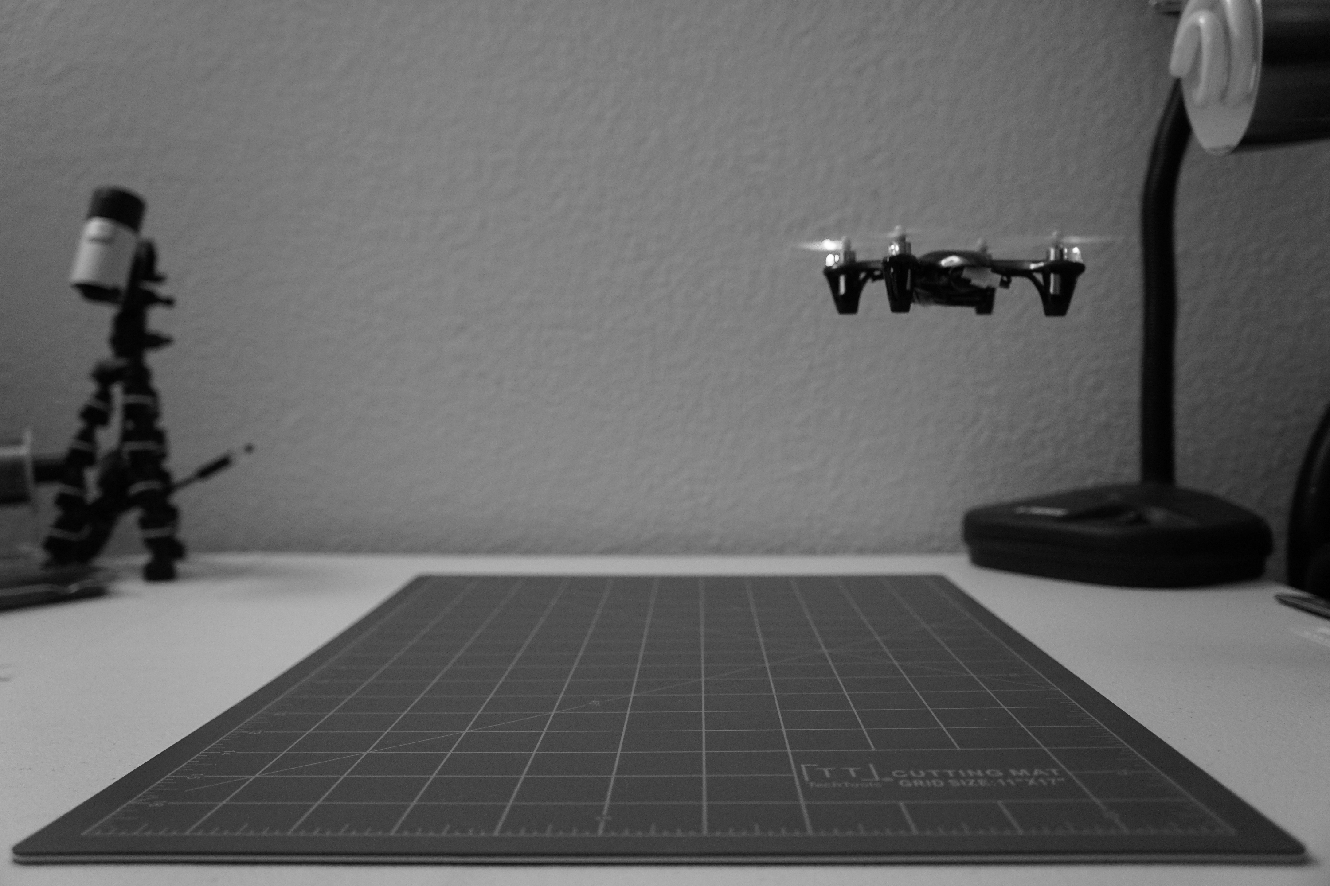
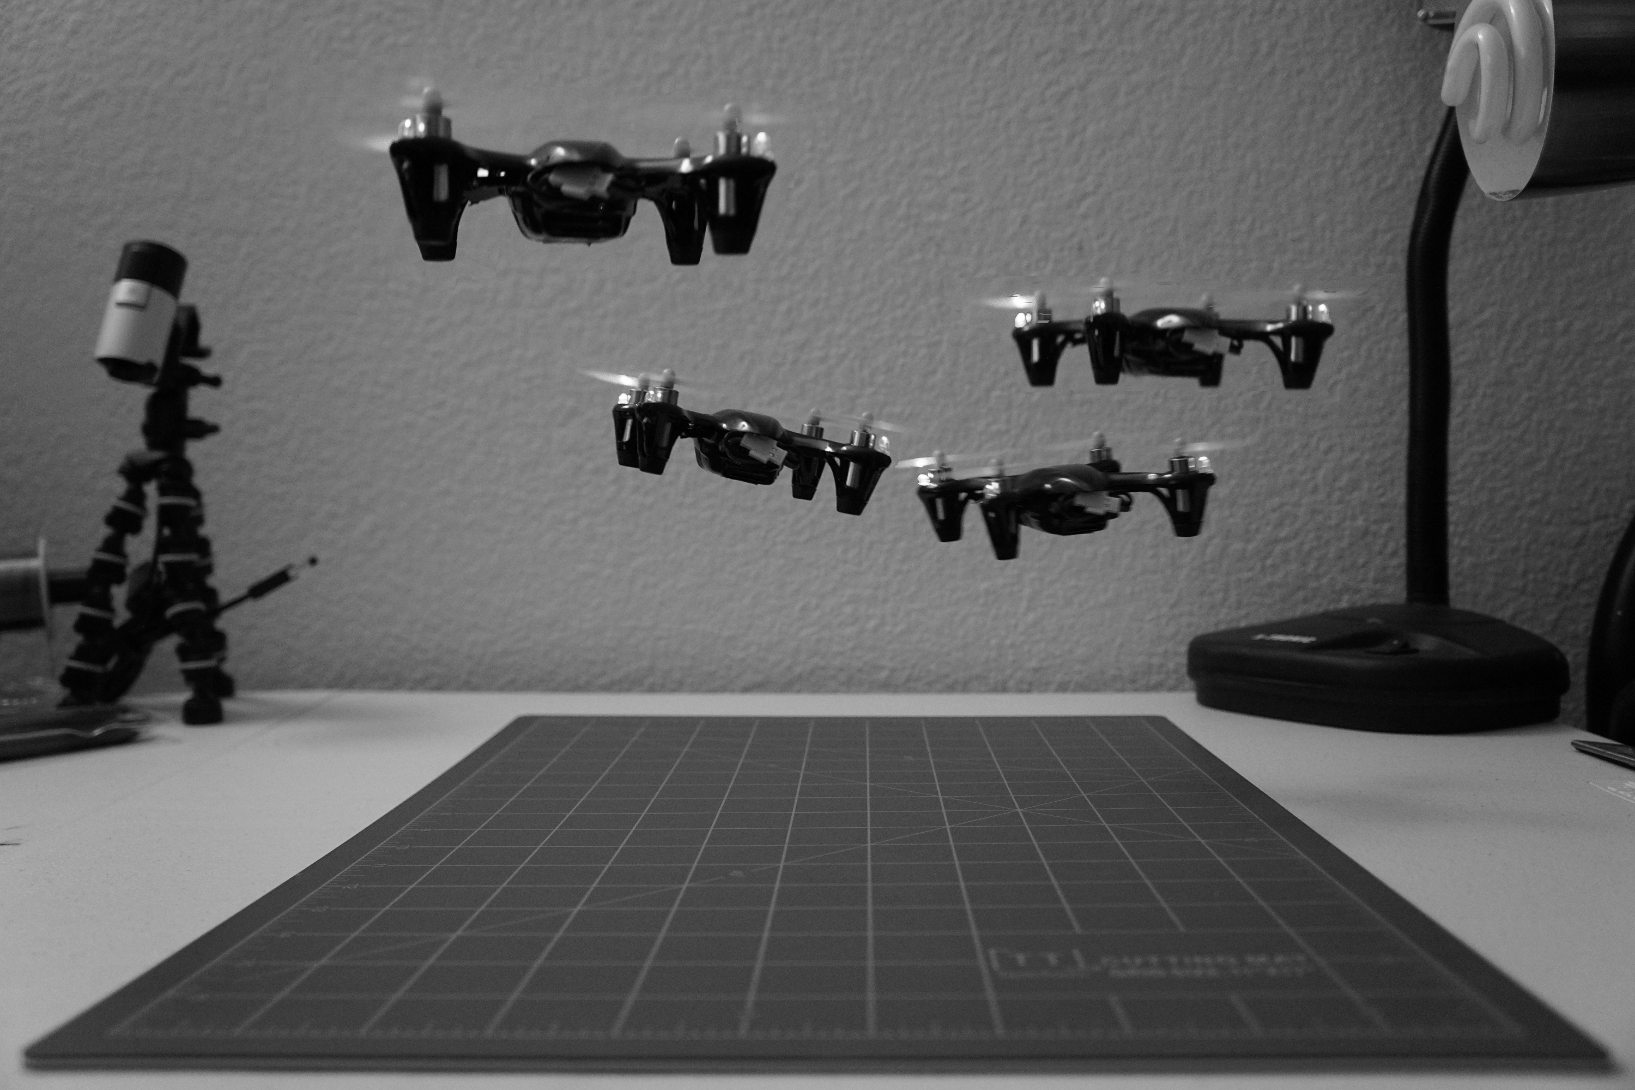
Image 1
Image 2
Image 3
Image 4
A quad of quads! This epsilon photograph captures a single quadcopter in motion. By overlaying 4 images of the quad in different positions in the three dimensional space, it appears as if there is a swarm!
Final
CS 6475

Slide 3
Details of the Pictures you Took
What are these images of?
These are images of a small quadcopter (60mm x 60mm) flying over a tabletop surface. Since the quadcopter is so small and inexpensive, it does not contain any robust stabilization sensors or mechanisms… so it can be rather difficult to hover in one place. The final image overlays all source images to compose a scene resembling a swarm of quadcopters, instead of just one.
CS 6475

Slide 4
Image 1
Here is the quad flying in the upper left of the scene.
CS 6475

Slide 5
Image 2
The quad dips down to the center.
CS 6475

Slide 6
Image 3
Stabilizing altitude. Don’t want to dip down to far…
CS 6475

Slide 7
Image 4
Quad flying in the upper right of the scene.
CS 6475

Slide 8
Final Image
The final image overlays the 4 source images to compose a scene with a swarm of flying quads, instead of just one. I utilized the GNU Image Manipulation Program (GIMP) to process the images.
Import the source images as layers.
Add a black (full transparency) layer mask to the first 3 images.
In each layer mask, remove the transparency region where each quad is located, so that it blends into the background of the last image.
Flatten and export.
CS 6475

Slide 9
What was the motivation/goal?
I finally decided to give up my smartphone’s camera and splurge on a nicer one. I purchased the Sony a6000, which contains a slew of features and manual control, including “lock on auto focus.” The camera itself was marketed as the world’s fastest autofocus system. The focus locking feature enables the camera to lock on an object and remain focused on that object, even if it moves within or out of the frame.
My goal of this assignment was to put that focus locking feature to the test. I used my Hubsan x4 quadcopter as the “object” and controlled it to fly around within the camera’s field of view. The quad is a fast-moving object, so I took a self-timer continuous burst shot to capture the flight. I took a bunch of pictures and extracted the best ones that remained in focus. It worked relatively well, but I think a different lens (smaller f-number) would improve the results.
CS 6475

Slide 10
How did you generate the final?
I generated the final image using the GNU Image Manipulation Program (GIMP). It was a relatively straightforward manual process; I didn’t take advantage of any automated photo merging tools. I was hoping to explore focus stacking and stitching processes, but I ran out of time... The general procedure to create the final overlayed image is as follows:
Import the source images as individual layers.
Add a black (full transparency) layer mask to the first 3 images.
In each layer mask, remove the transparency region where each quad is located, so that it blends into the background of the last image.
Flatten and export.
CS 6475

Slide 11
Was it successful?
The final image turned out okay. I’m not an expert on image processing and manipulation, so my knowledge of photo editing software was somewhat limited. I achieved my intended goal of composing a scene that appeared to be a swarm of flying drones. However, the blending wasn’t perfect due to differences in illumination (from the on-board LEDs of the quadcopter). Another goal of my approach was to test the focus locking feature on my camera, which returned fairly good results considering how fast the quad flies. I’d like to experiment with differences in illumination and lens types to try achieve a sharper image. I believe that using a faster lens would yield better results.
My method of overlaying the images to create the final image could also be improved with other techniques. Perhaps a background subrtraction and strategic Gaussian blur would create a better final composition.
CS 6475

Slide 12
Any other details.
I had a lot of difficulty with deciding what to photograph for this assignment. The requirements were so broad that I could’ve gone in countless directions. The potential for creativity here is endless. I wanted to explore focus stacking in more detail to bring objects at different distances into focus… to create an optical illusion effect. I wanted to see if it was possible to use computational processes to achieve the same effect as the Frazier lens, which achieves a massive depth of field. See the following video for examples of what the Frazier lens can achieve: https://youtu.be/06t8TGAffNA
Epsilon photography is an interesting concept, and I expect camera vendors to continue implementing more of these processes (HDR, stacking, etc.) in future cameras.
CS 6475

